Slide 1

Be water
Notes:
Adapt… Your resources, your presentation, think about your audience.

Slide 2
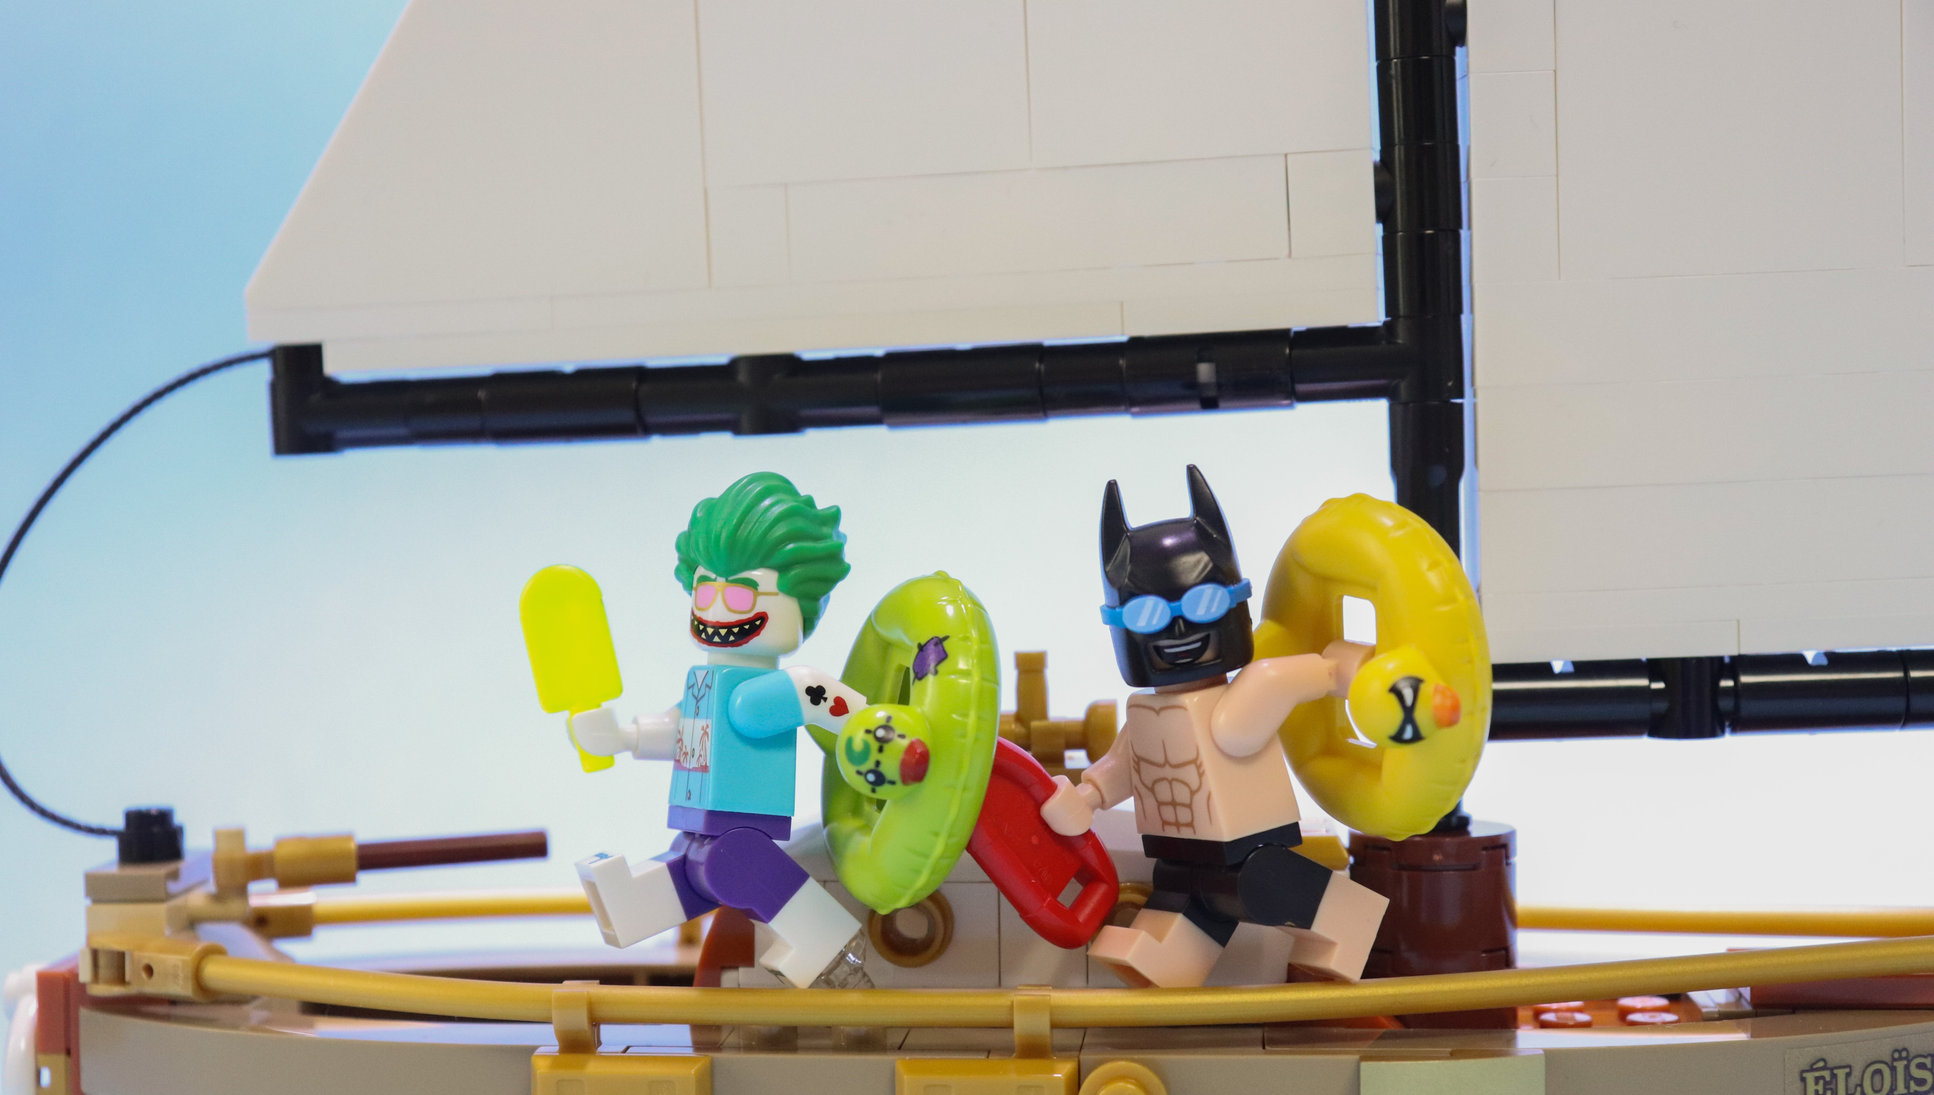
Have FUN!
Notes:
Adapt… Your resources, your presentation, think about your audience.

Slide 3
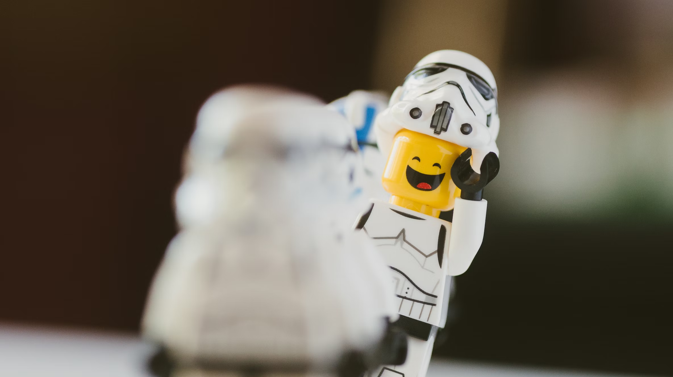
Feedback
Notes:
Adapt… Your resources, your presentation, think about your audience.

Slide 4

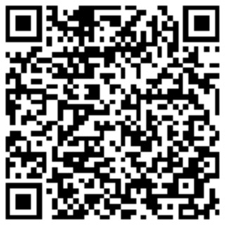
Feedback
Notes:
Adapt… Your resources, your presentation, think about your audience.

